Slide 1
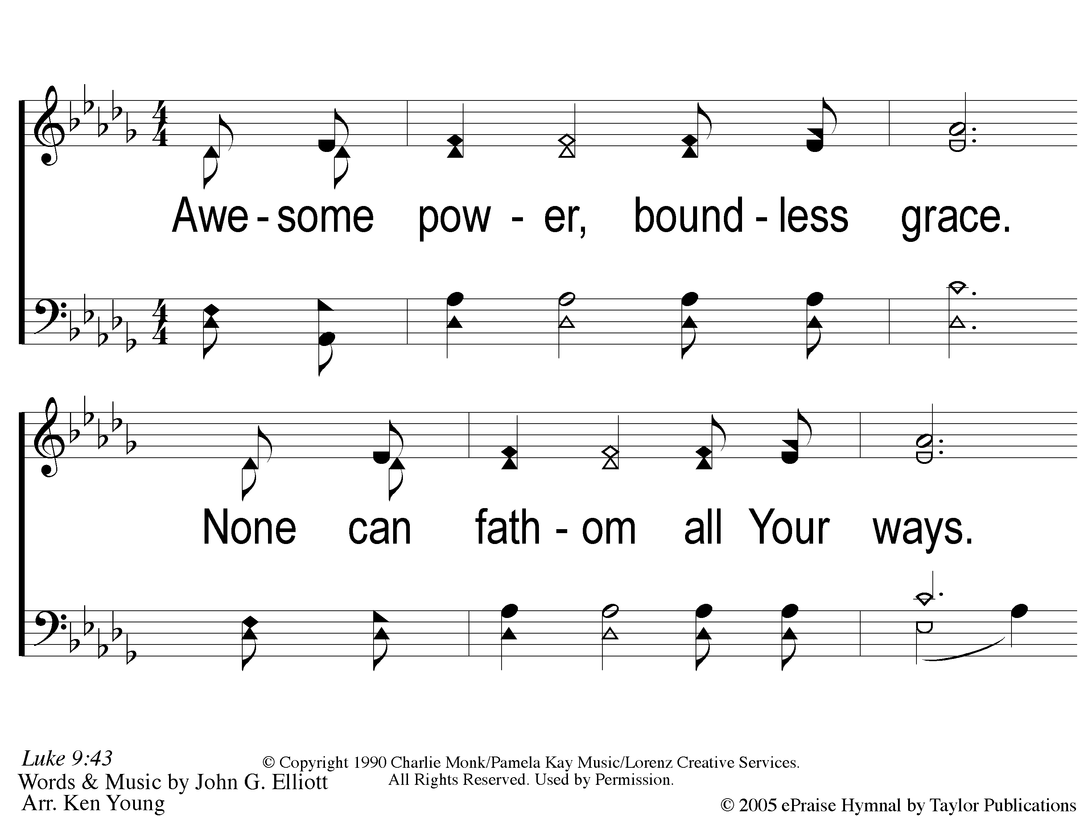
1 Awesome Power
Awesome Power
39

Slide 2
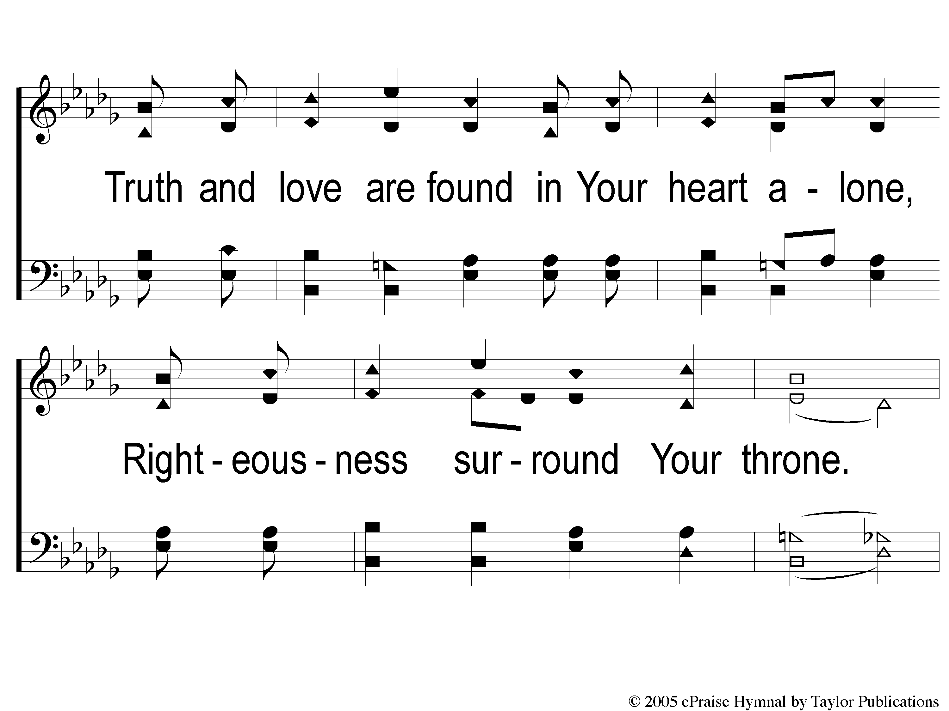
2 Awesome Power
Awesome Power
39

Slide 3
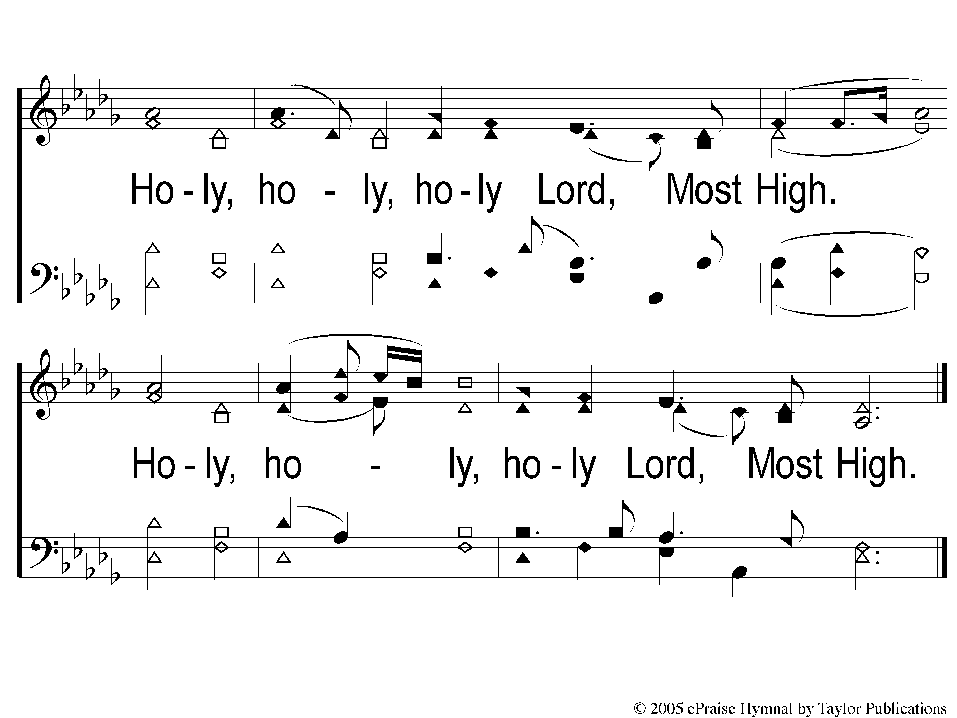
3 Awesome Power
Awesome Power
39

